Slide 1
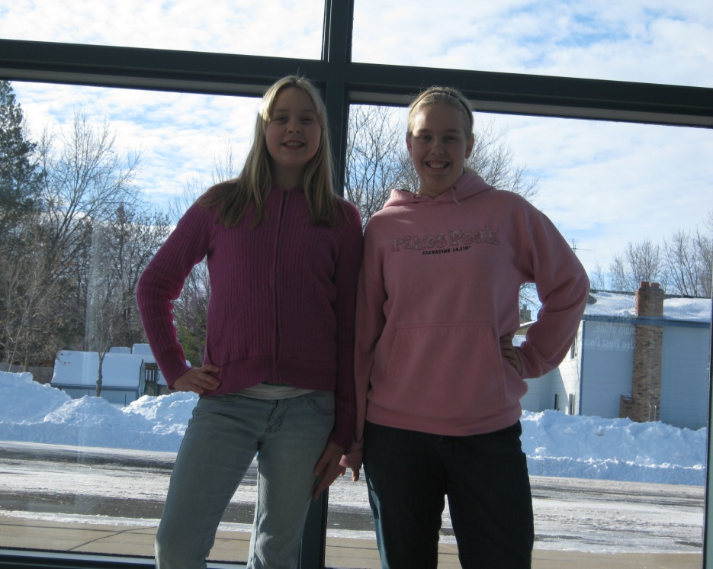
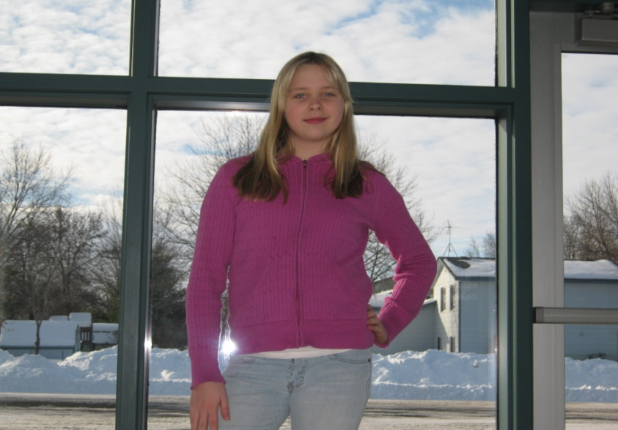
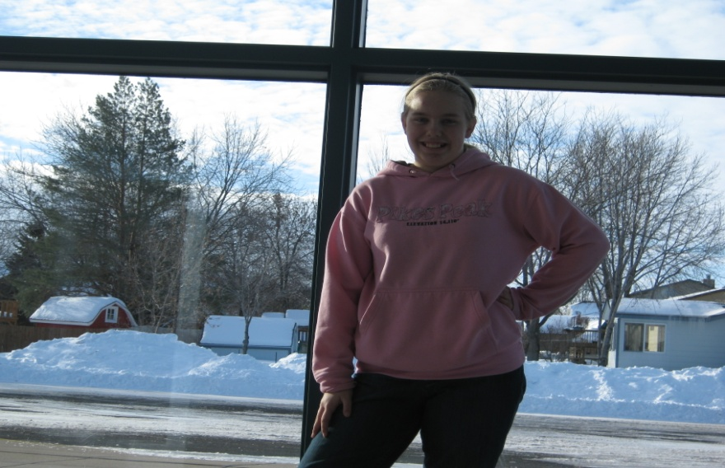
Stephanie Torbert

Slide 2
One great photographer
“Photography is like a meditation for me. It is such a concentrated moment.” She started taking photos in the late 20th century. She takes photos of flowers, fluorescent lights, reflections, and architecture. She would stand in front of a scene or object and wait for inspiration. –Stephanie Torbert

Slide 3
Comparing Photos
Autumn Blaze
2010
Stephanie Torbert
Protean Landscape
1990

Slide 4
Comparing Photos
Springs Awaken
2010
Stephanie Torbert
Amaryllis Spring
1996

Slide 5
Comparing Photos
Reflect ’O Pencils/Pens
2010
Stephanie Torbert

Slide 6
Comparing Photos
Snowy Glaze,
2010
Stephanie Torbert

Slide 7
Comparing Photos
Evening Sun
2010
Stephanie Torbert

Slide 8
Our Experience
From our experience we learned all about angles, lighting, and about Stephanie Torbert. We would like to give our thanks to her for being a good roll model photographer for us. In conclusion. We learned that it does matter what angle or the way you light it. We also learned the rule of threes, and that rule helped a lot when we were taking photos. It helped us learn many things that will help in the future. Thanks for watching our great slide show.

